Slide 1
Sage AR Automation Webinar
30th April 2025

Slide 2
Agenda
Enhancements
Issues
DRAFT

Slide 3
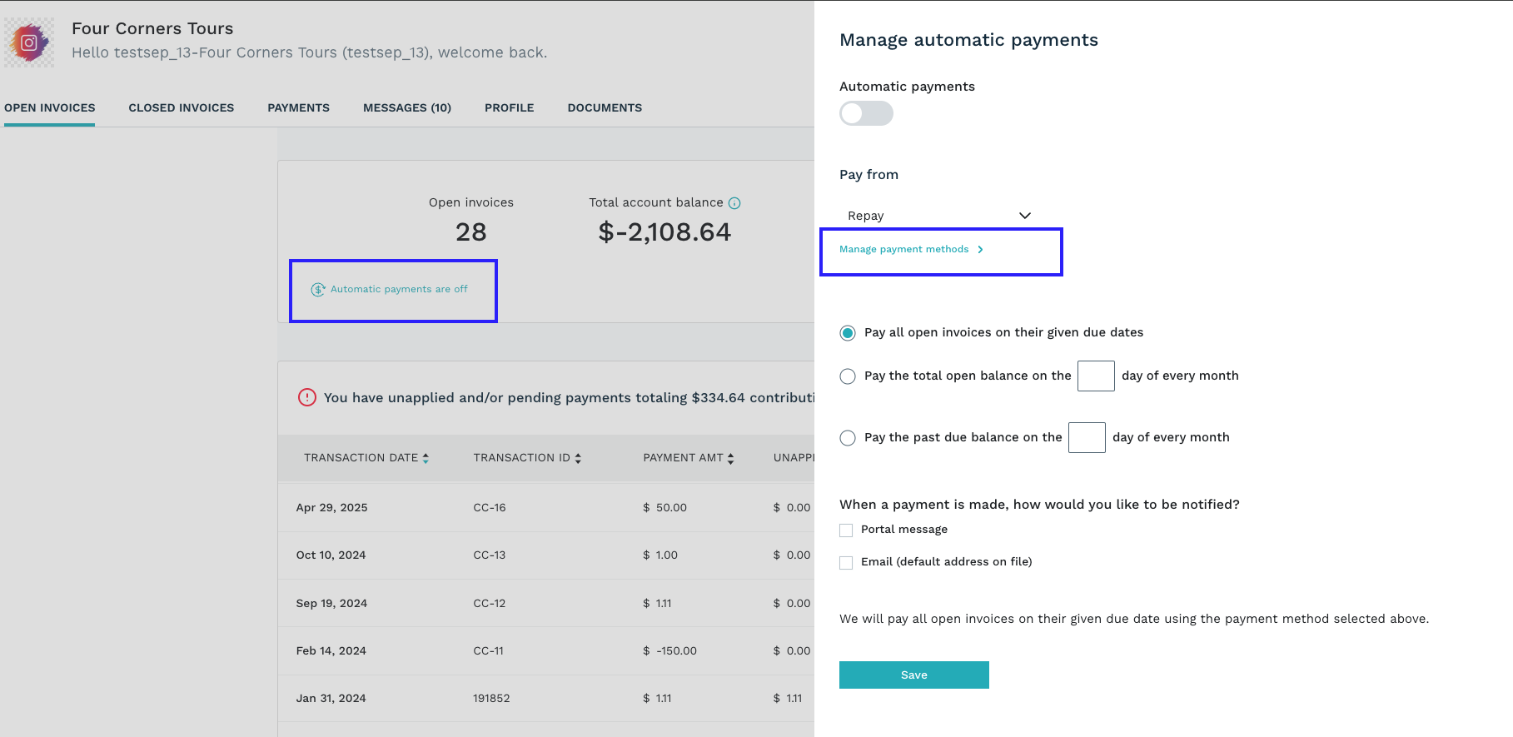
Enhancement 1 : : SS Portal -Autopay enhancement
Functional Flow
  Open SS Portal
  Navigate to Open Invoices
  Select Automatic payments are off
  Popup appears for manage automatic payments
DRAFT
Notes:
Screenshot from Product Board Backlog
View = (Feature Backlog > Grouped by Release > Hierarchy)

Slide 4
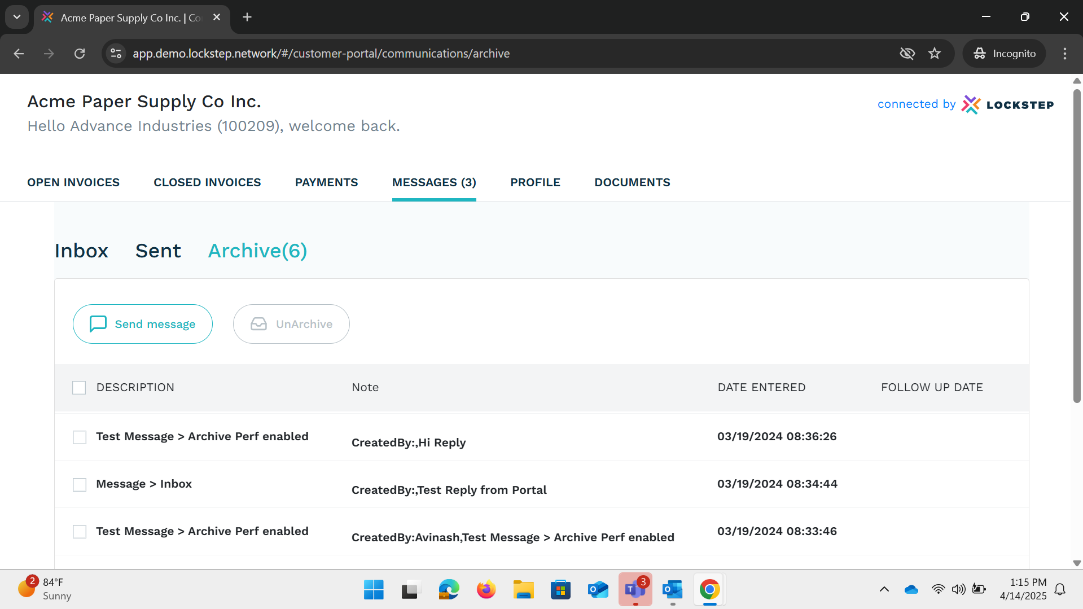
Enhancement 2: Archive Options for messages is now available in SS Portal
Functional Flow
  Open SS Portal
  Navigate to Messages Tab
  Archive from Sent Items/Inbox - data moved to Archived Tab
DRAFT
Notes:
Screenshot from Product Board Backlog
View = (Feature Backlog > Grouped by Release > Hierarchy)

Slide 5
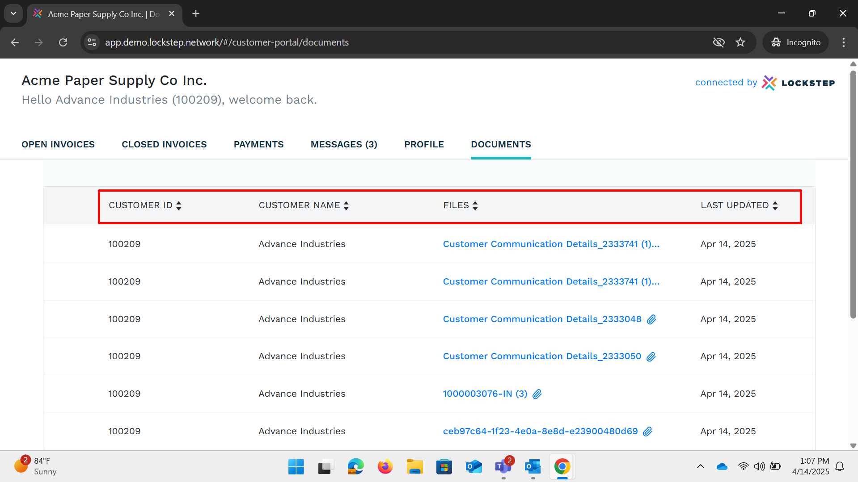
Enhancement 3: : Sorting on custName column for document page is available in SS Portal
Functional Flow
  Open SS Portal
  Navigate to Documents Tab – Added Sorting for Columns
DRAFT
Notes:
Screenshot from Product Board Backlog
View = (Feature Backlog > Grouped by Release > Hierarchy)

Slide 6
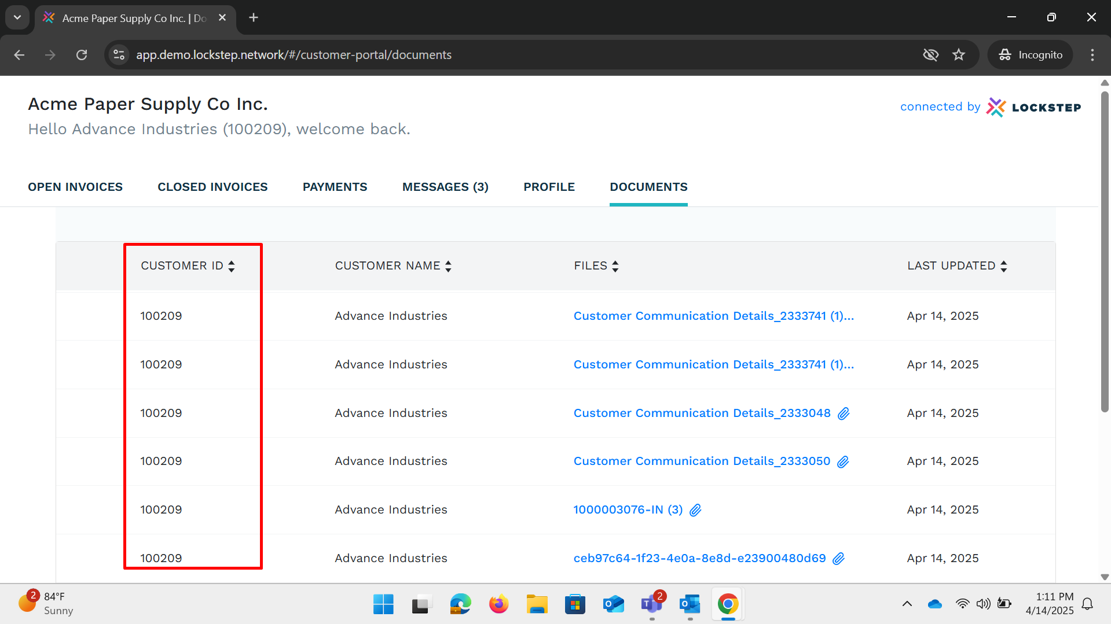
Enhancement 4: added customer ID column in documents page
Functional Flow
  Open SS Portal
  Navigate to Documents Tab > Added Customer ID Column
DRAFT
Notes:
Screenshot from Product Board Backlog
View = (Feature Backlog > Grouped by Release > Hierarchy)

Slide 7
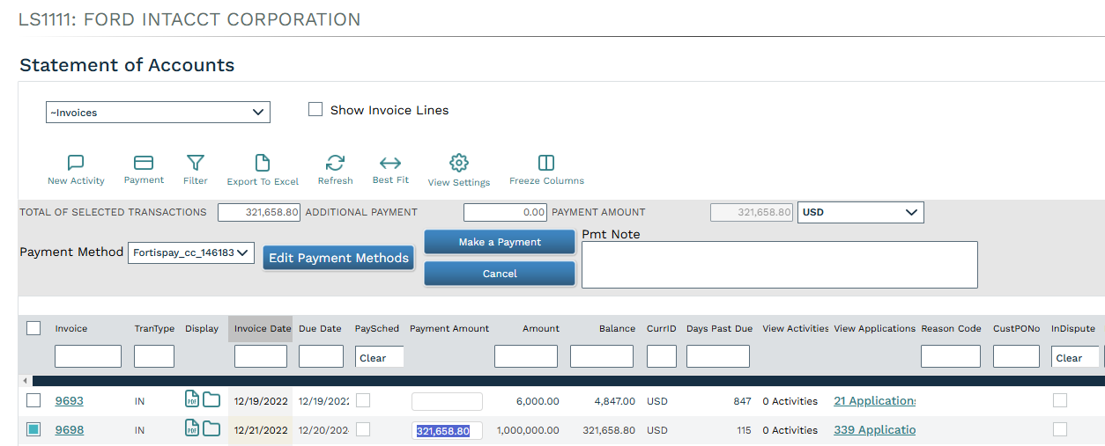
Issue 1: User able to make partial payments from webclient when 'Allow Partial Pmts' option is disabled from company setting
Functional Flow
  Login to webclient and navigate to company page.
  Update company settings with "Allow Partial Pmts" as false.
  Navigate to account details page and validate that payment amount for invoice cannot be updated.
DRAFT
Notes:
Screenshot from Product Board Backlog
View = (Feature Backlog > Grouped by Release > Hierarchy)

Slide 8
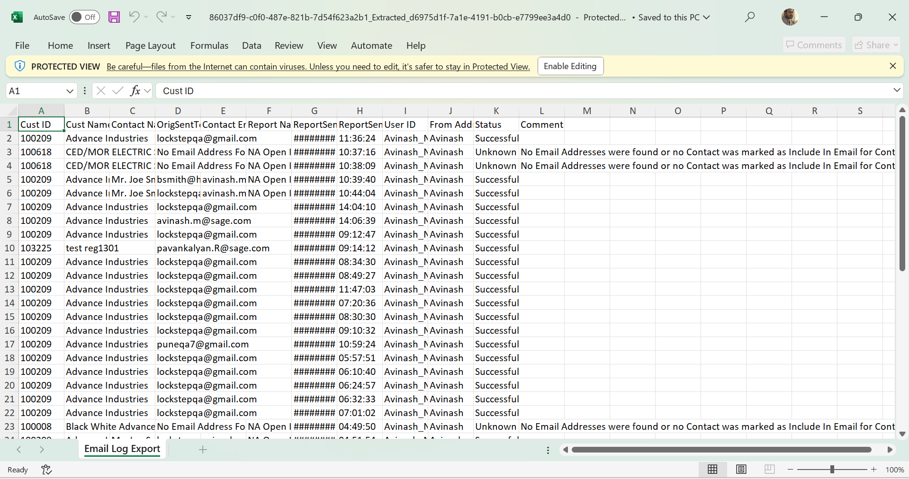
Issue 1 : Users are now able to export logs to excel from the email tab on the Logs page
Functional Flow
  Navigate to Admin > Settings & Utilities > Logs (Email)
  Export to Excel > Validate columns available on Exported File
DRAFT
Notes:
Screenshot from Product Board Backlog
View = (Feature Backlog > Grouped by Release > Hierarchy)

Slide 9
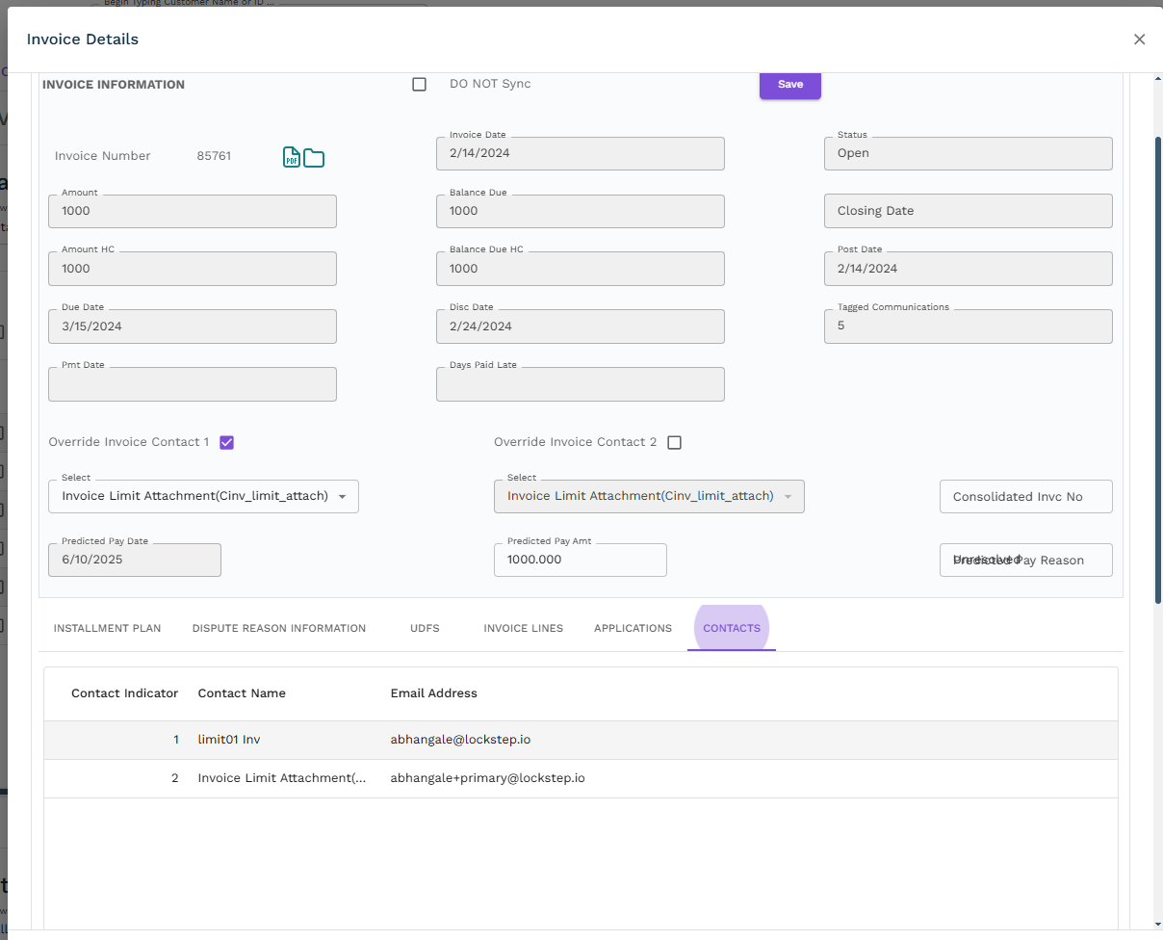
Enhancement 1 : Addition of Invoice Contacts Tab on Invoice information view
Functional Flow
Go to Account overview for any customer.
Open invoice view for the invoice which has invoice contact available.
Click on contacts tab and it will show invoice contacts data.
DRAFT
Notes:
Screenshot from Product Board Backlog
View = (Feature Backlog > Grouped by Release > Hierarchy)

Slide 10
    Thank You!

